Slide 1

Keeping Up with the Latest Headlines
TEAM MEMBERS:
B.SANTHOSH(7B6FBFE5RB12A99938746BCFA8667959)
K.HARIHARASUTHAN(9768CE290F7D87C844445906A9FC5279)
R.SIBI(8FAB599E191AC3874B4E549F9F9E166)
K.KABILAN(8EC25C20ZBEA187963741D110060806C)
tKt
team

Slide 2

Understanding the News Cycle
1
Breaking News
Immediate coverage of events as they happen. Timely and engaging.
2
Follow-Up Reports
Deeper insights follow initial reports, offering more context and analysis.
3
Opinion Pieces
Experts provide perspectives and interpretations of ongoing developments.

Slide 3




Identifying Credible News Sources
Reliability
Trustworthy sources verify facts and provide balanced reporting.
Verification
Cross-reference facts with multiple reputable outlets for accuracy.
Transparency
Sources should disclose their methods and corrections openly.

Slide 4




Analyzing Headline Trends
Keyword Analysis
Source Diversity
Engagement Data
Identify frequent terms that indicate emerging trends.
Consider different perspectives to see varying trends.
Assess reader engagement to gauge public interest in topics.

Slide 5
Avoiding Information Overload
Limit Sources
Schedule Breaks
Prioritize Topics
Choose selective outlets to manage information intake effectively.
Regular breaks can prevent news fatigue and maintain focus.
Focus on what matters most to you and skip lesser interests.

Slide 6

Separating Fact from Fiction
1
Spotting Misinformation
2
Context Matters
3
Avoid Echo Chambers
Be aware of false claims by checking source credibility.
Evaluate the full context rather than isolated events.
Engage with diverse opinions to challenge assumptions.

Slide 7

Navigating Breaking News
Stay Informed
Stay Calm
Use reliable alerts to stay updated on significant events quickly.
Process news calmly to understand the situation better.
Share Responsibly
Verify information before sharing to prevent spreading misinformation.

Slide 8

Developing a News Filtering Strategy
Method
Description
Custom Alerts
Set specific topics to receive instant updates.
RSS Feeds
Subscribe to feeds for direct updates from trusted sources.
Block Lists
Exclude sources that consistently provide low-quality content.

Slide 9
Incorporating News into Decision-making
Current Events
Expert Opinions
Trend Analysis
Economic and political updates impact business and personal choices.
Insights from specialists can guide informed decisions.
Recognizing trends can forecast future opportunities and threats.

Slide 10
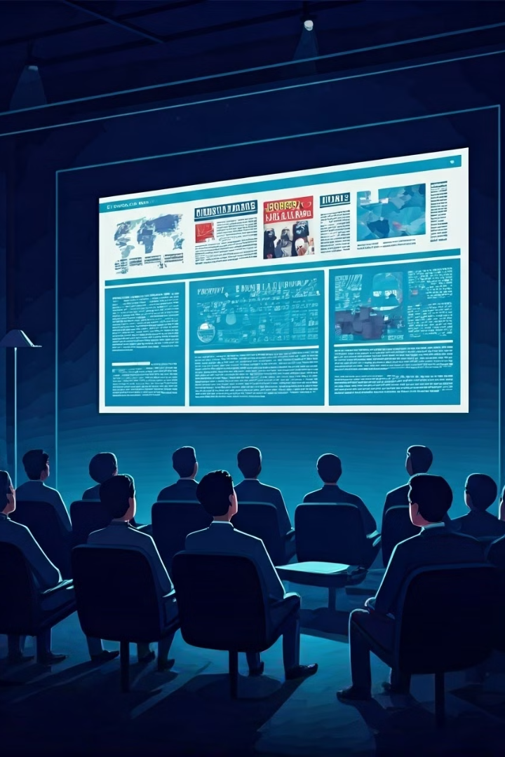
Staying Informed and Engaged
1
Regular Reading
2
Community Discussions
Consistent reading ensures you remain knowledgeable.
Engaging in discussions amplifies understanding and interest.
3
Active Participation
Take part in forums and talks to stay well-versed.

Slide 11


The Art of Crafting Killer Headlines
In today's digital age, a captivating headline is more crucial than ever. It's the first impression, the digital handshake that can make or break your content's success.

Slide 12

Introduction: Why Headlines Matter
Attention Grabbers Headlines act as magnets for attention in a sea of content. A strong headline makes your content stand out.
Relevance Filters
They help readers decide if your content is worth their time. A clear, concise headline quickly conveys the topic.
Engagement Drivers
Compelling headlines pique curiosity and entice clicks. They promise value and offer a glimpse into the content's benefits.

Slide 13
Understanding the Anatomy of an Effective Headline
Keywords
Relevant terms that your target audience is searching for.
Numbers
Quantifiable data or lists that promise specific takeaways.
Power Words
Emotionally charged words that evoke curiosity, urgency, or excitement

Slide 14

3
2
Headline Best Practices: Clarity, Conciseness, and Curiosity
1
Keep it brief and impactful. Aim for 6-8 words or under 60 characters.
Curiosity
Conciseness

Slide 15
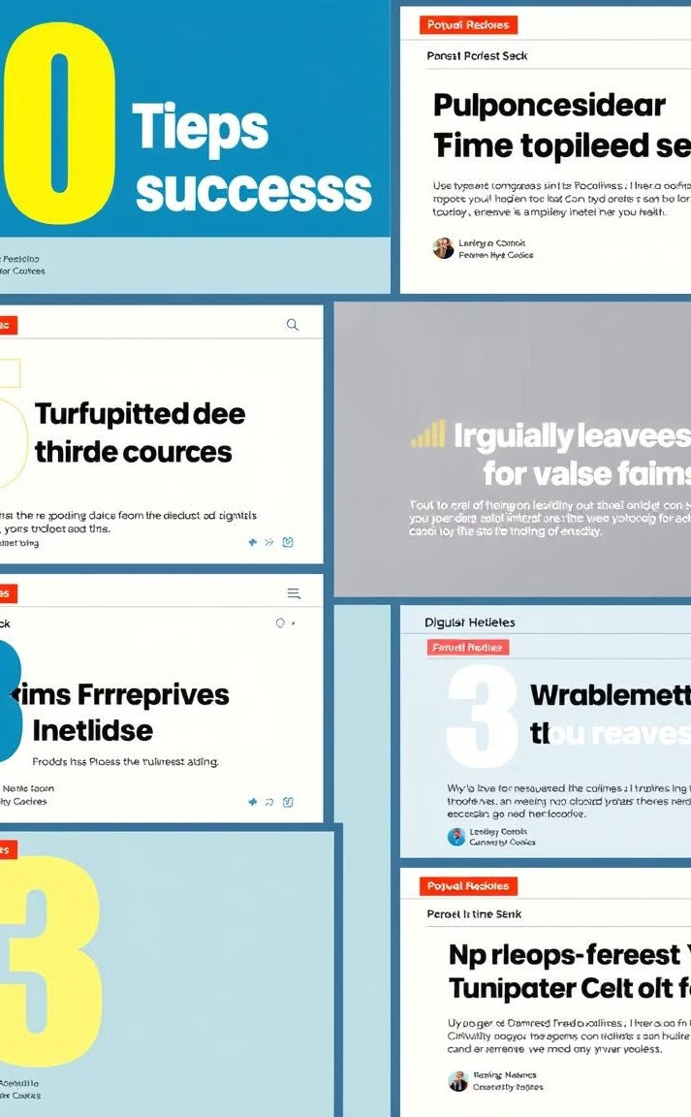
Trending Headline Tactics: Listicles, How-To's, and Questions
Listicles
Offer easily digestible information, appealing to our love for organized content.
How-To's
Provide practical solutions and tap into the desire for self- improvement.
Questions
Engage readers by addressing their pain points or piquing their curiosity.

Slide 16
Optimizing Headlines for Search and Social
Search (SEO)
Incorporate relevant keywords to improve visibility
in search engine results.
Social Media
Tailor headlines for shareability and engagement. Use strong verbs and emotional langu.age

Slide 17
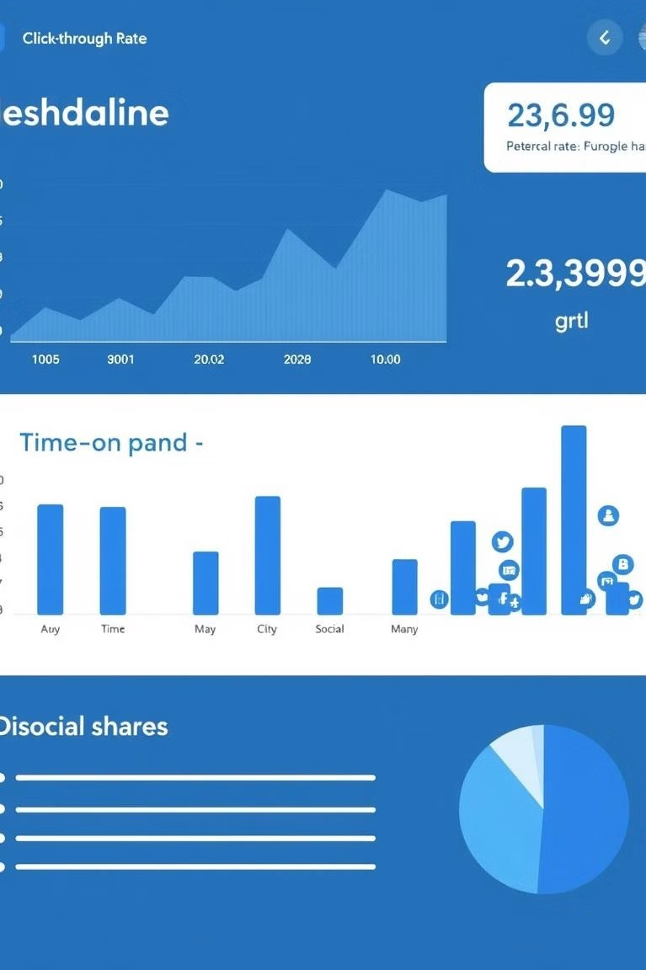
Measuring Headline Performance: Metrics that Matter
Click-Through Rate (CTR) | Percentage of users who click on your headline.
Time on Page | Duration visitors spend engaging with your content.
Social Shares | Number of times your content is shared on social media.

Slide 18

Crafting Headlines for Different Content Types
Posts
Intriguing and informative, enticing readers to dive into the content.

Slide 19
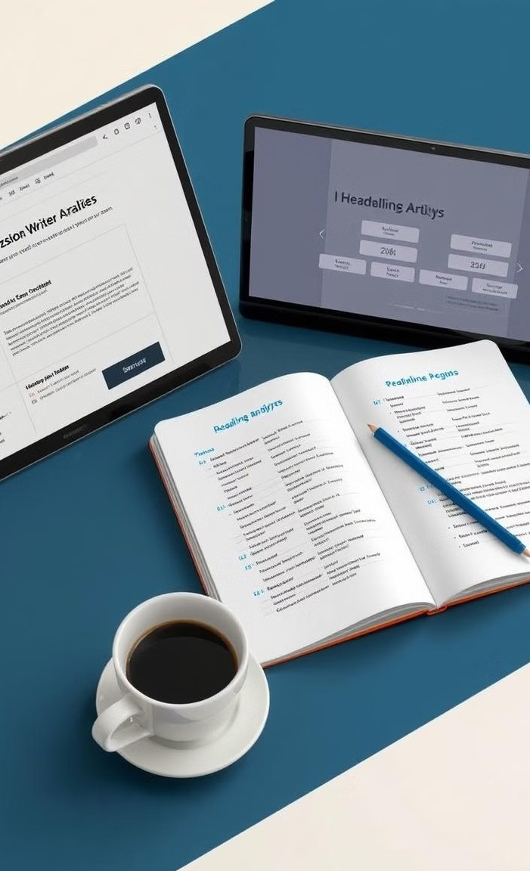
Headline Writing: Techniques and Tools
.
A/B Testing
Compare the performance of different headlines to see what resonates best.
Loosing the Brainstoming
Generate multiple headline options before che best.
r

Slide 20
THANK YOU

